Slide 1

Enhancement of Security and Visual Quality in Image Steganography
by
R. Nithya
Roll No. 204G1A0568
U. Raghavi
Roll No. 204G1A0575
M. Rithika
Roll No. 204G1A0582
G. Vasanth Kumar
Roll No. 204G1A05C1
Under the guidance of
Mr. L. Suman M.Tech(Ph.D)
Assistant Professor
Department of Computer Science and Engineering
Srinivasa Ramanujan Institute of Technology
(Autonomus)
2023 - 2024

Slide 2
Contents
Abstract
Problem statement
Objectives of Project
Literature survey for first objective
Literature survey for second objective
Proposed Work -(Methods to be followed for proposed system)
References
GitHub Link
Queries

Slide 3
Abstract
In today’s digital era, securing sensitive information during communication has become a paramount concern. This lead to the exploration of advanced methods to combine steganography and cryptography. The steganography is the art of hiding data in another data.
Image Steganography is a operation of hiding message into cover image. The main objective is to hide the secret message into an image and enhance the payload capacity by using k-Least Significant Bit(LSB) algorithm, improvise the visual quality by using Relative Global Histogram Stretching(RGHS) based on adaptive parameter acquisition. To protect and provide security for the hidden message Advanced Encryption Standard(AES) algorithm is used. To ensure robustness, multi cover images are used to hide the data. Efficiency of the algorithm is estimated by Peak Signal to Noise Ratio(PSNR), where higher PSNR value gives the higher quality image.
Keywords : Steganography, k-LSB, RGHS, AES,

Slide 4
Problem Statement
A good steganographic method aims at three aspects, payload capacity, visual quality, security.
This project seeks to develop an advanced image steganography system that combines various techniques to achieve secure data hiding, robustness and enhanced visual quality.
The primary goal is to embed secret message within the image using k-Least Significant Bit algorithm, AES(Advanced Encryption Standard) encryption for data security and RGHS(Relative Global Histogram Stretching) enhancement to improve the visual appearance of the stego image.
Furthermore this system aims to achieve minimum Mean square error value and higher Peak Signal to Noise Ratio(PSNR) value indicating high fidelity between stego image and original image.

Slide 5
Objectives of Project
To develop and evaluate a solution to ensure secret communication by integrating the k-Least Significant Bit (LSB) technique with the Advanced Encryption Standard (AES) algorithm. The primary goal is to develop an integrated method that increases the data embedding capacity, provides high security to the hidden data by using multiple cover images to store the data to be hidden.
To enhance the visual appearance and quality of the stego image because after extracting the hidden image, the resolution can be affected. For that and in order to enhance the image quality, the image quality enhancement method Relative Global Histogram Stretching (RGHS) based on adaptive parameter acquisition is used. With this improvisation of image quality this system is determined to achieve higher Peak Signal to Noise Ratio(PSNR) value.

Slide 6
Literature survey for first objective
This paper describes the process of hiding an image into another using k-Least Significant Bits. Based on LSB coding, a k-LSB based method is proposed using k least bits to hide the image. After hidding the image into cover image, the resolution of stego image may be affected.For that an image enhancement method called RGHS based on adaptive parameter acquisition is used to enhance the image resolution.[1]
In this paper a clear and precise ways to implement text and image steganography is proposed. For better understanding the author divided the process of image steganography into two as LSB encoder and LSB decoder and this proposed system also implements AES encryption algorithm for providing security.[2]

Slide 7
Literature survey for first objective
This paper proposes the implementation of Least Significant Bit Image steganography with Advanced Encryption Standard. The proposed methodology consists of 4 modules namely encryption,encoding ,decryption, decoding. The size of the message embeded is 600 bytes.[3]
In this paper, the author wisely used the fact of Theory of colors ,which is blue –voilet cones require more light energy than for the red or green cones thereby making difficult for the human eyes to observe minor changes in the color intensities. By taking an advantage out of this a 2:2:4 LSB insertion method is proposed. For this proposed system, author preffer bitmap images.[4]

Slide 8
Literature survey for second objective
In this paper a detailed description regarding digital image encryption technique based on AES(Advanced Encryption Standard) algorithm is proposed along with the implementation of AES encryption and decryption. For better analysis histogram analysis of image encryption and test of key sensitivity results are also provided.[5]
In this paper, the authors proposed a simple but very effective image enhancement method called Relative Global Histogram Stretching(RGHS) based on adaptive parameter acquisition. This proposed approach was mainly implemented for shallow-water image enhancement. It mainly consists of two parts- contrast correction and color correction.[6]

Slide 9
Proposed System
To overcome the drawbacks of the existing system , this proposed system implements image steganography using k-Least Significant Bit algorithm because in order to embed high amount of data we need replacement of more least significant bits and to extend the flexibility of the proposed system format converter is introduced to convert JPG format to PNG or TIFF.
To enhance the security, cryptographic encryption algorithm AES is applied. To improve the security further in our proposed system, Multi Image Steganography is used which involves embedding data within multiple cover images, typically in a way that makes the hidden message more secure and less suspectable to detection.

Slide 10
Proposed System
After extracting the hidden message from an image the resolution of the hidden and stego images may be affected. For that in order to enhance the image quality, the image quality enhancement method such as Relative Global Histogram Stretching based on adaptive parameter acquisition is used which enhances the contrast and dynamic range of an image.
The effectiveness of the proposed system is evaluated by the metric Peak Signal to Noise Ratio(PSNR).PSNR measures the ratio of noise between the stego and original image. The higher the PSNR value the higher the image quality.

Slide 11
References
[1].Omar Elharrouss, Noor Almaadeed, Somaya Al-Maadeed , “An Image Steganography approach based on k – least significant bits(k-LSB)” , 2020 IEEE International Conference on Informatics, IoT ,and Enabling Technologies(ICIoT), Pages:5,Published Date: 11 May 2020.
[2].Priya Paresh Bandekar, G. C. Suguna, “LSB based text and image steganography using AES algorithm”, 2018 3rd International Conference on Communication and Electronics System(ICCES),Pages:7, Published Date: 16 oct 2018.
[3].Addit Pabbi, Rakshit Malhotra, Manikandan K, “Implementation of least significant bit image steganography with Advanced Encryption Standard”, School of Computer Science and Engineering Vellore institute of technology ,Published Date: March 5 2021.
[4].AmritPal Singh, Harpal Singh, “An Improved LSB based Image Steganography Technique for RGB images”, Dept. of Computer Science and Engineering, Guru Kashi University Talwandi Sabo, India, Date:Mar5 2015.

Slide 12
References
[5].Qi Zhang, Qun Ding, “Digital Image Encryption Based on Advanced Encryption Standard”, 2015 Electronic Engineering College, Heilongjiang University Harbin, China, Pages:4, Published Date: 20 Sep 2015.
[6]. Huang, D., Wang, Y., Song, W., Sequeira, J. and Mavromatis, S., 2018, February. “Shallow-water image enhancement using relative global histogram stretching based on adaptive parameter acquisition”, International Conference on Multimedia Modelling (pp. 453-465). Springer, Cham.

Slide 13
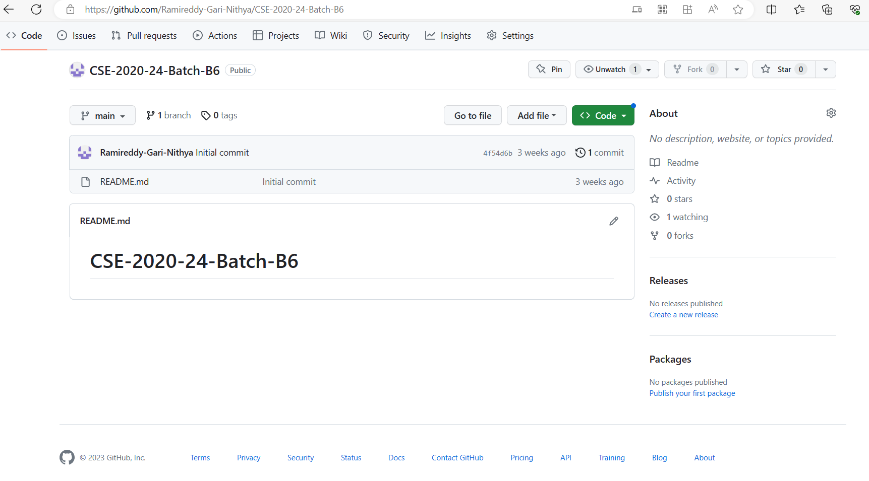
Git Hub Dashboards of each student
Github link: https://github.com/Ramireddy-Gari-Nithya/CSE-2020-24-Batch-B6

Slide 14
Any Queries?

